Slide 1
Software Requirement Engineering
Requirement Workshop
Muhammad Nasir
m.nasir@iiu.edu.pk

Slide 2
Outline
Accelerating the Decision Process
Preparing the Workshop
Setting the Agenda
Running the Workshop

Slide 3
Requirement Workshop
The requirements workshop may be the most powerful technique for eliciting requirements.
It gathers all key stakeholders together for a short but intensely focused period.
The use of an outside facilitator experienced in requirements management can help ensure the success of the workshop.
Brainstorming is the most important part of the workshop.

Slide 4
Requirement Workshop
In general, the more elicitation and requirements gathering techniques the team has in their toolkit, the more effective the team will be.
However, occasionally the team does not have the luxury of time to either master or apply a variety of techniques.
They have to pick one technique and go.

Slide 5
Requirement Workshop
If we were to be given only one requirements elicitation technique—one that we had to apply in every circumstance, no matter the project context, no matter what the time frame—
We would pick the requirements workshop
When mastered, can really help change project outcomes, even when it's the only elicitation technique applied.

Slide 6
Requirement Workshop
The requirements workshop is designed to encourage consensus on the requirements of the application
To gain rapid agreement on a course of action, all in a very short time.
With this technique, key stakeholders of the project gather together for a short, intensive period, typically no more than one or two days.

Slide 7
Requirement Workshop
The workshop is facilitated by a team member or, better yet, by an experienced outside facilitator
Focuses on the creation or review of the high-level features to be delivered by the new application.

Slide 8
Requirements’ Workshop Benefits
It assists in building an effective team, committed to one common purpose: the success of this project.
All stakeholders get their say; no one is left out.
It forges an agreement between the stakeholders and the development team as to what the application must do.

Slide 9
Requirements’ Workshop Benefits
It can expose and resolve political issues that are interfering with project success.
The output, a preliminary system definition at the features level, is available immediately.

Slide 10
Preparing for Workshop
Proper preparation for the workshop is critical to success.
Selling the Concept
First, it may be necessary to sell the concept inside the organization by communicating the benefits of the workshop approach to prospective members of the team.

Slide 11
Preparing for Workshop
Ensuring the Participation of the Right Stakeholders
Identifying stakeholders who can contribute to the process and whose needs must be met in order to ensure a successful outcome.

Slide 12
Preparing for Workshop
Attending to Logistics
A poorly organized workshop is unlikely to achieve the desired result.
Logistics involve everything from:
  Structuring the proper invitation
  Travel arrangements
  Lighting in the workshop meeting room.

Slide 13
Preparing for Workshop
If you approach logistics with a high degree of professionalism,
It will be obvious to the attendees that this is indeed an important event, and they will act accordingly.
You'll also have a more successful workshop.

Slide 14
Preparing for Workshop
Providing Warm-Up Materials
  Fourth, send materials out in advance of the workshop to prepare the attendees and also to increase productivity at the workshop session.
  These materials set each attendee's frame of mind.

Slide 15
Preparing for Workshop
Providing Warm-Up Materials
  We call this "getting their minds right." One of the messages we need to deliver is that this is not yet another meeting.
  This may be our one chance to get it right.

Slide 16
Preparing for Workshop
We recommend that you provide two types of warm-up materials.
  Project-specific information
  Out-of-the-box thinking preparation
Warm-up materials should spur both in-context and out-of-the-box thinking

Slide 17
Project-specific Information
drafts of requirements documents,
bulleted lists of suggested features,
copies of interviews with prospective users,
analyst's reports on trends in the industry,
letters from customers,
bug reports from the existing system,
new management directives,
new marketing data, and so on.

Slide 18
Project-specific Information
Although it's important not to bury the prospective attendees in data,
It's also important to make sure they have the right data.

Slide 19
Out-of-the-box thinking Preparation
Part of "getting their minds right" is encouraging attendees to think "out of the box."
"Forget for a minute what you know and what can't be done due to politics.
Forget that we tried to get management buy-in last time and failed.

Slide 20
Out-of-the-box thinking Preparation
Forget that we haven't yet solidified our development process.
Simply bring your insights on the features of this new project and be prepared to think 'out of the box.'

Slide 21
Preparing for Workshop
Tip
  Do not send the data out too far in advance.
  You do not want the attendees to read it and forget it, and you don't want the long planning cycle to decrease their sense of urgency.
  Send the data out anywhere from two days to one week in advance. In all likelihood, the attendees will read it on the plane or at the last minute anyway.
  That's OK; it will help them be in the right frame of mind for the session.

Slide 22
Choosing the Facilitator
To ensure success, we recommend that the workshop be run by someone outside the organization, a non-stakeholder,
Someone who is un-affected by any particular outcome and has no role in the company other than to see a successful workshop outcome.

Slide 23
Choosing the Facilitator
Ideally, the facilitator will also have experience with the unique challenges and charged atmosphere of the requirements management process.
However, if this is simply not practical in your environment, the workshop could be facilitated by a team member if that person:

Slide 24
Choosing the Facilitator
  Has received some training in the process
  Has demonstrated solid consensus-building or team-building skills
  Is well respected by both the internal and external team members
  Is strong enough to chair what could be a challenging meeting

Slide 25
Choosing the Facilitator
If the workshop is to be facilitated by a team member, that person must not contribute to the ideas and issues at the meeting.
Otherwise, the workshop is in danger of losing the objectivity that is necessary to get at the real facts,
It may not foster a trusting environment in which a consensus can emerge.

Slide 26
Responsibilities of the facilitator
Establish a professional and objective tone for the meeting.
Start and stop the meeting on time.
Establish and enforce the "rules" for the meeting.
Introduce the goals and agenda for the meeting.
Manage the meeting and keep the team "on track."

Slide 27
Responsibilities of the facilitator
Facilitate a process of decision and consensus making but avoid participating in the content.
Manage any facilities and logistics issues to ensure that the focus remains on the agenda.
Make certain that all stakeholders participate and have their input heard.
Control disruptive or unproductive behavior.

Slide 28
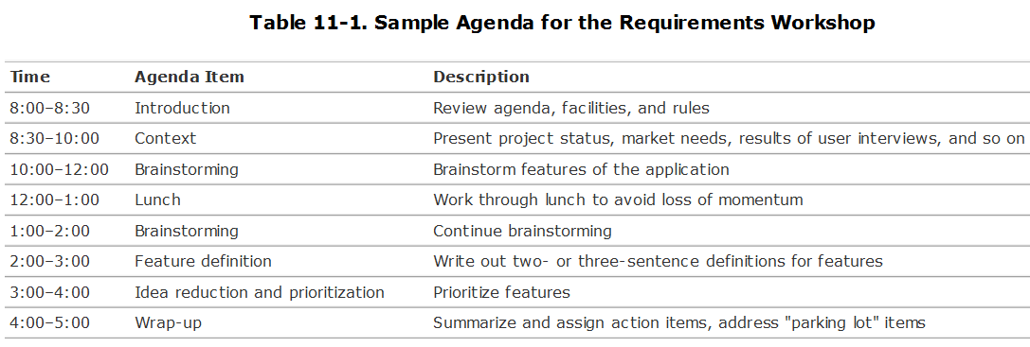
Setting the Agenda

Slide 29
Running the Workshop
Facilitator has a crucial role to play.
To make matters even more exciting, these workshops are often characterized by a highly charged atmosphere.
Many facilitators carry a "bag of tricks" with them to help manage this highly charged atmosphere

Slide 30

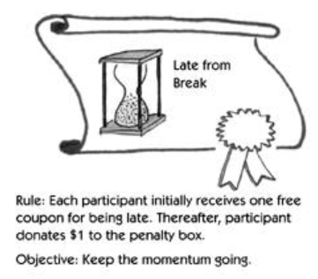
Workshop Tickets

Slide 31
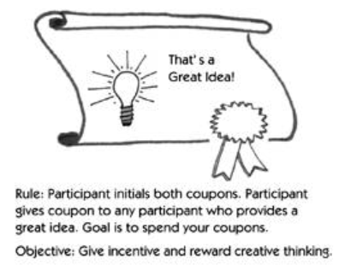
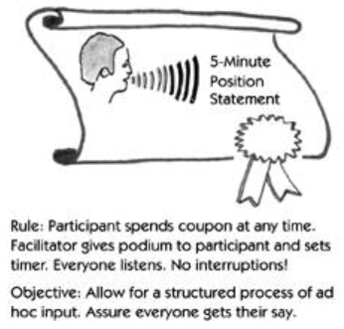
Workshop Tickets

Slide 32
The End
Thanks for listening
Questions would be appreciated.

